Slide 1
Focal plane image while changing pulse duration

Slide 2
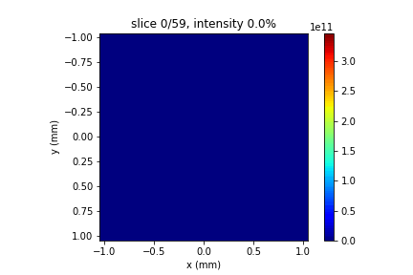
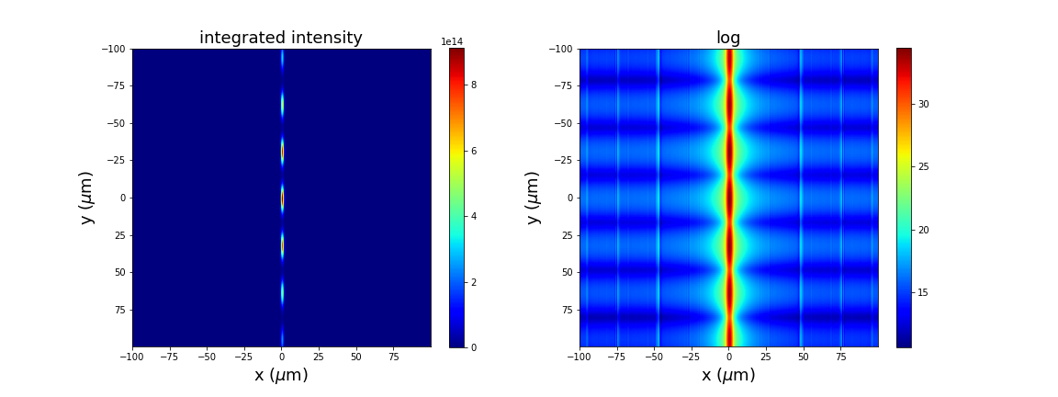
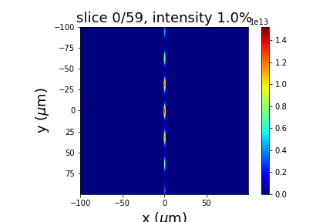
Input beam, 1fs, 60 slices
Integrated intensity over 60 slices
1fs, 60, 25
Focused beam

Slide 3
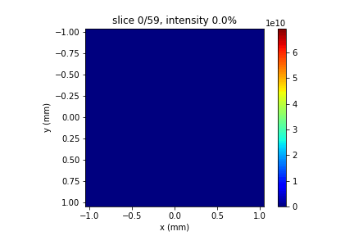
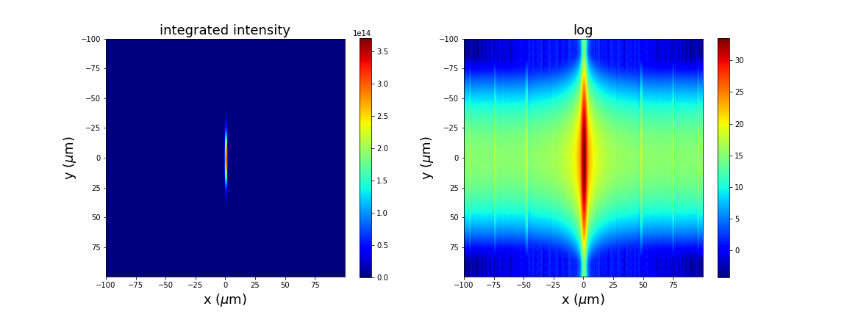

Input beam, 5fs, 60 slices
Integrated intensity over 60 slices
5fs, 60, 25
Focused beam

Slide 4

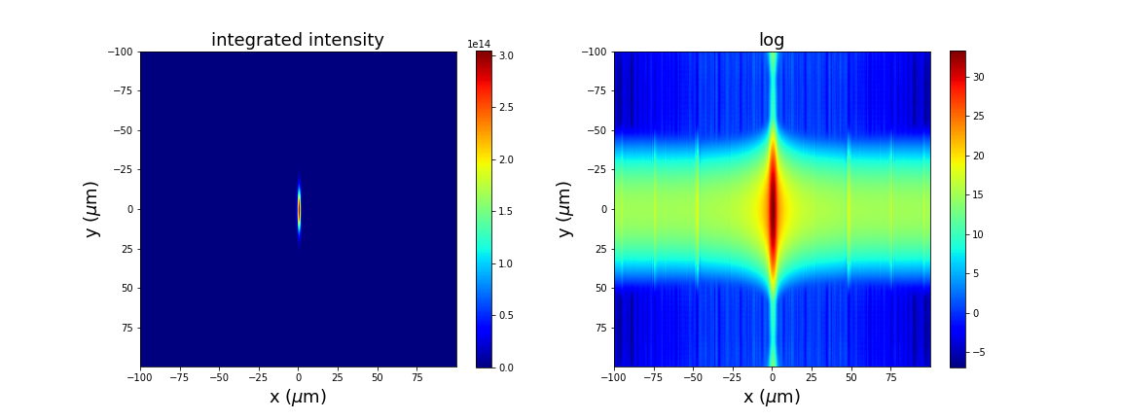
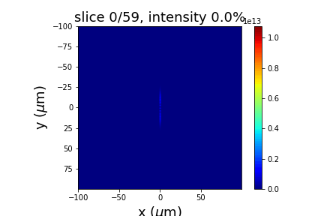
Input beam, 10fs, 60 slices
Integrated intensity over 60 slices
10fs, 60, 25
Focused beam

Slide 5
Temporal slices (1mm) while changing pulse duration

Slide 6
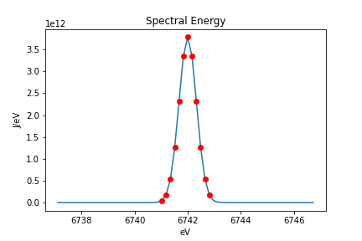
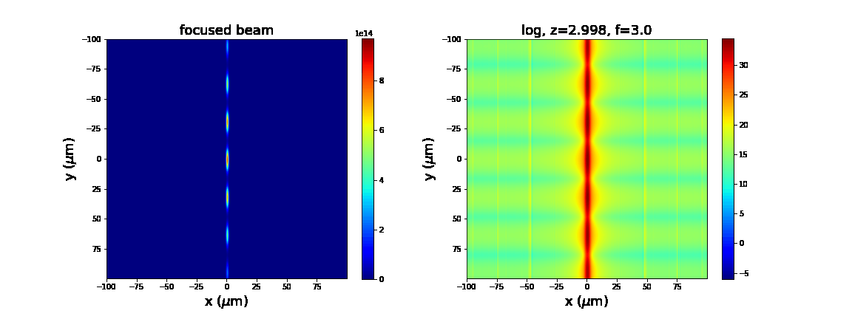
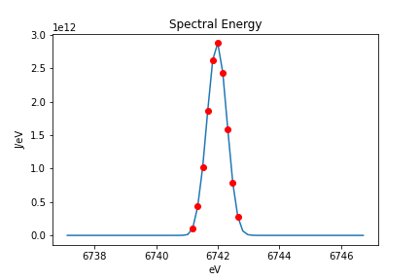
Input beam spectrum
Integrated intensity over 60 slices
tslices
1fs, 60, 25
Reflected beam

Slide 7
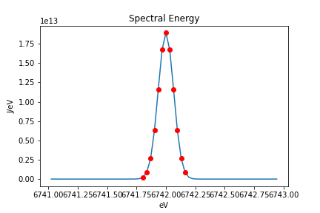
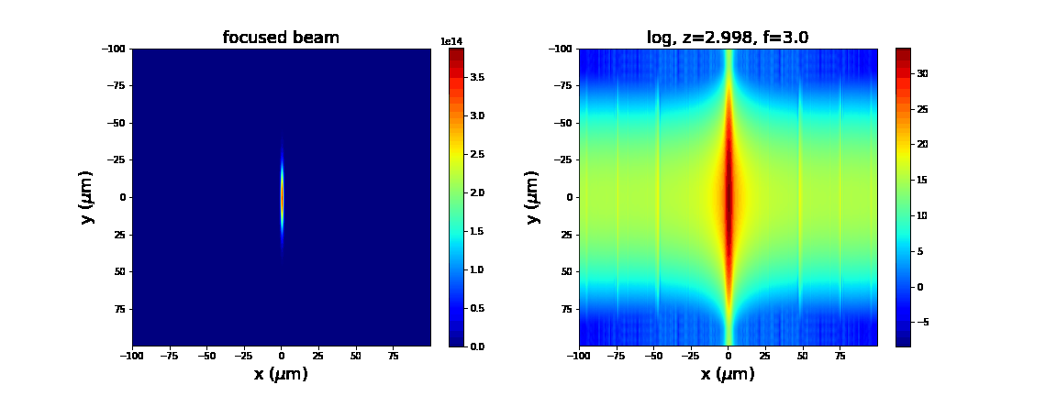
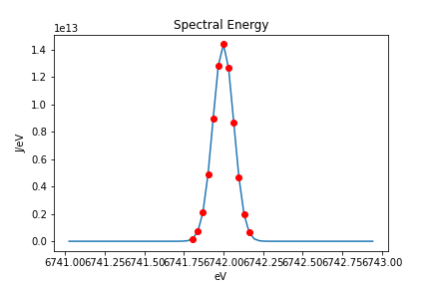
Input beam spectrum
Integrated intensity over 60 slices
tslices
5fs, 60, 25
Reflected beam

Slide 8
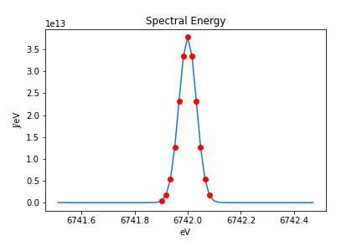
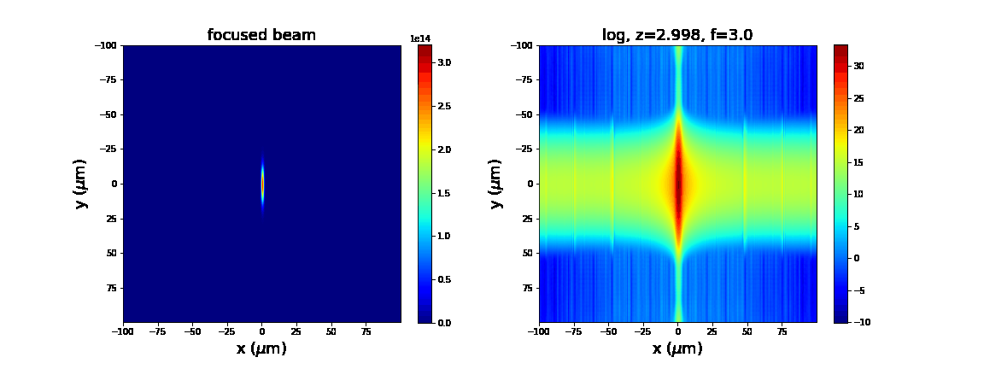
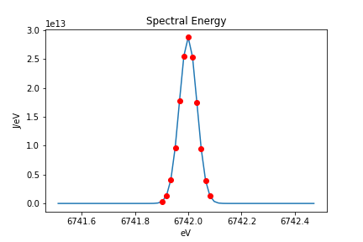
Input beam spectrum
Integrated intensity over 60 slices
tslices
10fs, 60, 25
Reflected beam

Slide 9
Temporal slices (2mm) while changing frequency domain sampling (pulseRange)

Slide 10

Input beam spectrum
Integrated intensity over 60 slices
tslices
1fs, 60, 25
Reflected beam

Slide 11
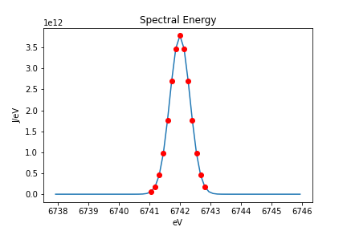
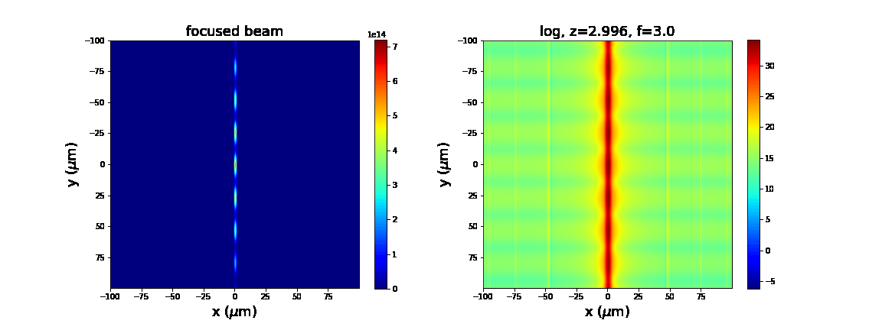
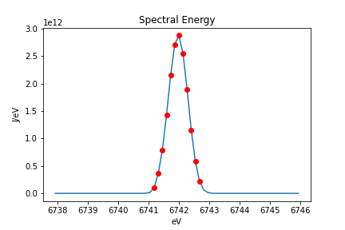
Input beam spectrum
Integrated intensity over 60 slices
tslices
1fs, 60, 30
Reflected beam

Slide 12
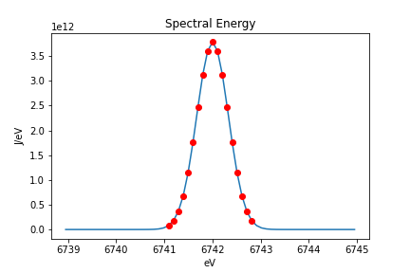
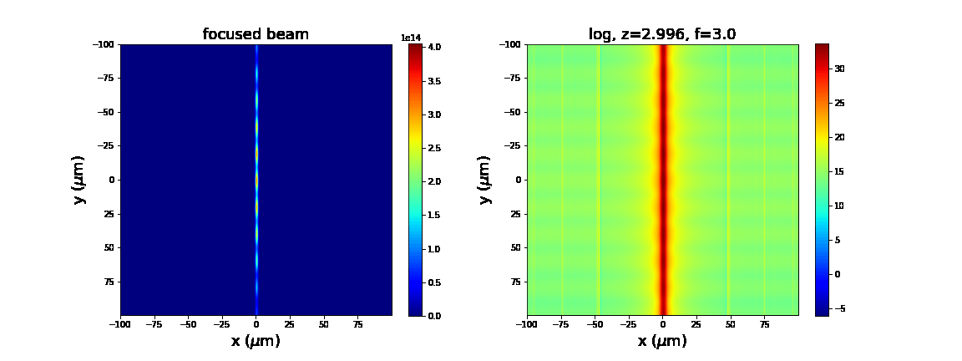
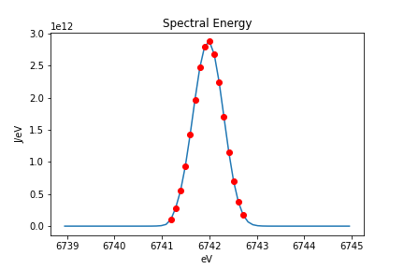
Input beam spectrum
Integrated intensity over 60 slices
tslices
1fs, 60, 40
Reflected beam

Slide 13
Temporal slices (2mm) while changing time domain sampling (nz)

Slide 14
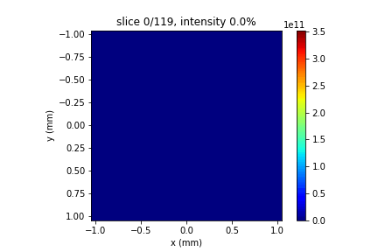
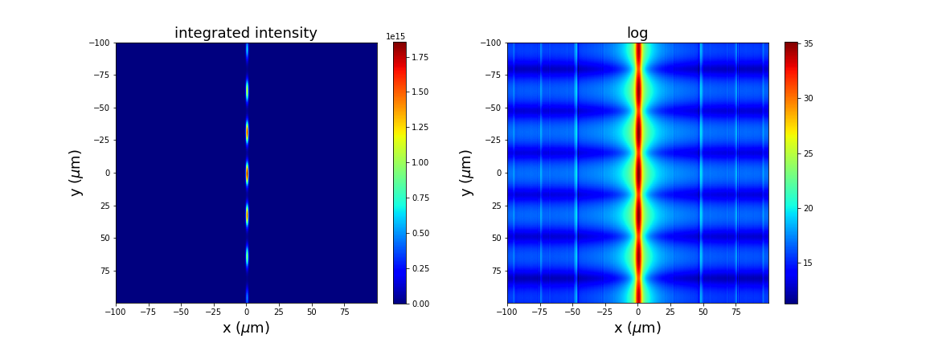

Input beam, 1fs, 120 slices
Integrated intensity over 120 slices
1fs, 120
Focused beam

Slide 15

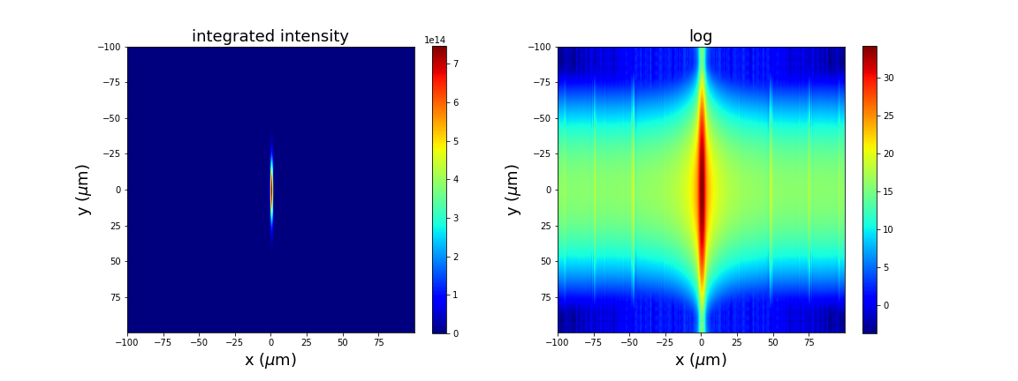

Input beam, 5fs, 120 slices
Integrated intensity over 120 slices
5fs, 120
Focused beam

Slide 16



Input beam, 10fs, 120 slices
Integrated intensity over 120 slices
10fs, 120
Focused beam

